Slide 1
Stanley- DC tools

Slide 2
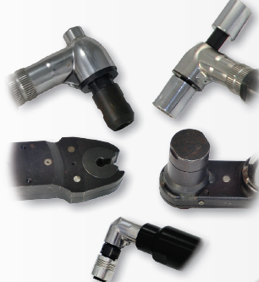
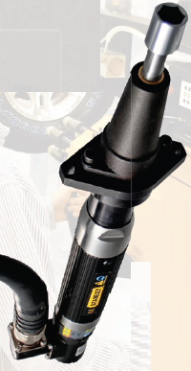
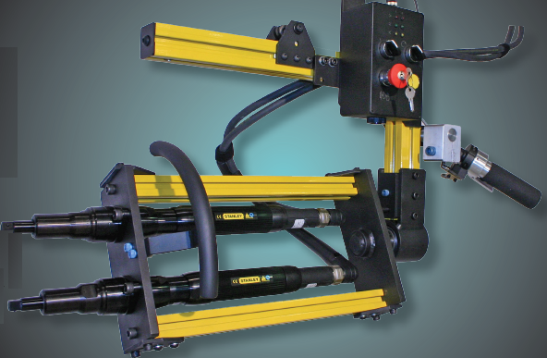
Stanley- DC tools
Notes:
IP : Ingress Protection against solids & liquids

Slide 3
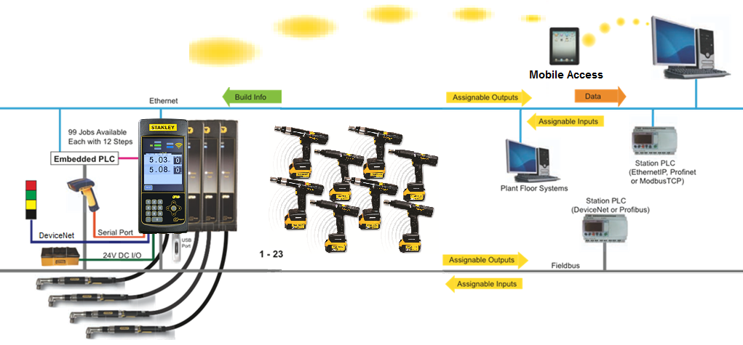
Controller compatibly
Notes:
IP : Ingress Protection against solids & liquids

