Slide 1

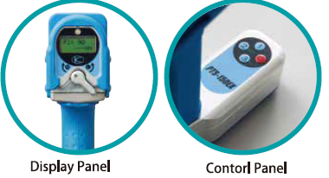

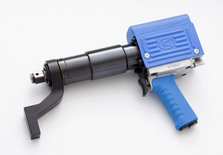
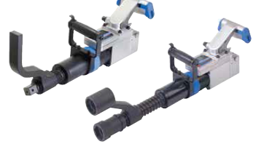

PACE ASSEMBLY TOOLS

Slide 2

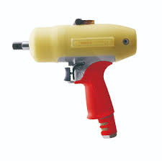
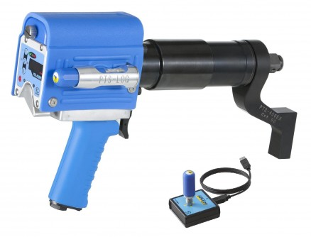
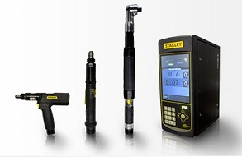
Where does KUKEN PTS series Stand
Oil Pulse Tools
Right Here.!
DC Tools

Slide 3

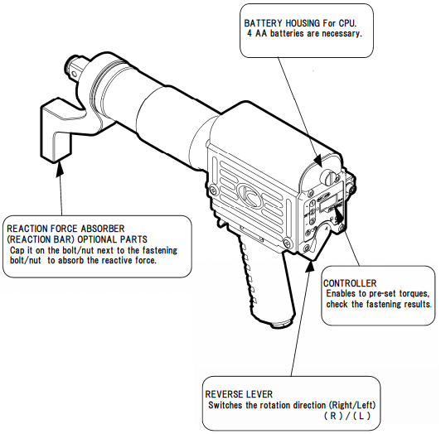
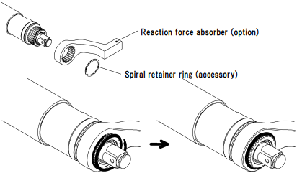
Why so.??
Features :
1.) In built CONTROLLER
2.) Reaction Arm with Spiral retainer

Slide 4

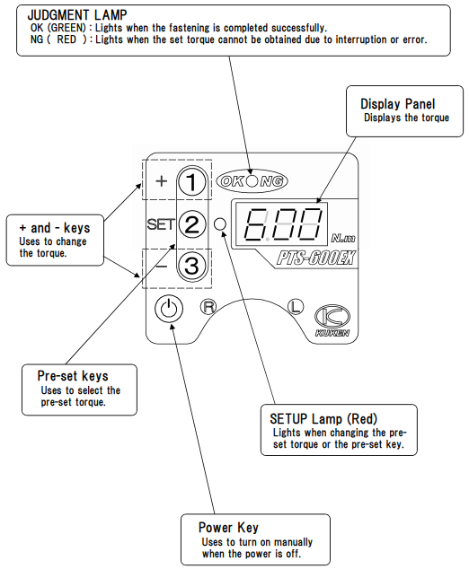
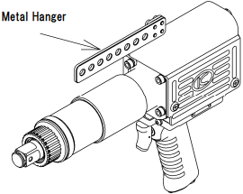
Why so.??
Features :
1.) Ease of Parameter Set-up
2.) Optional Hanging arrangement

Slide 5

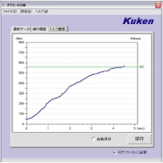


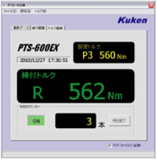
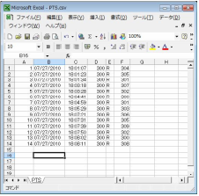
Why so.??
High Accuracy
&
Complete data recording with analysis

Slide 6


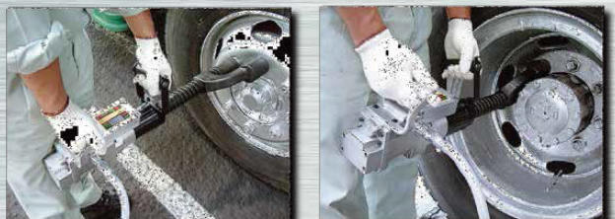
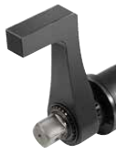

Hanging and Torque reaction arrangement for KUKEN PTS series

Slide 7
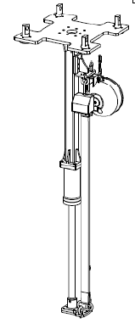
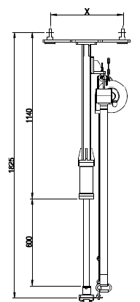
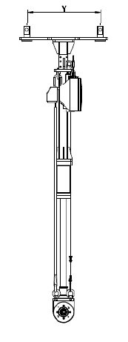

Reaction Bar & Hanging arrangement for up to 5000Nm available for KUKEN PTS Series

Slide 8
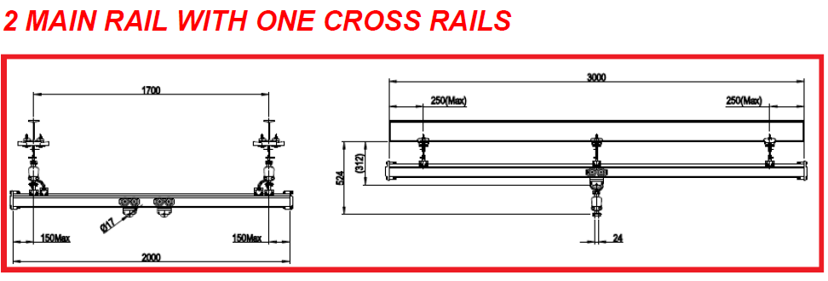


Slide 9
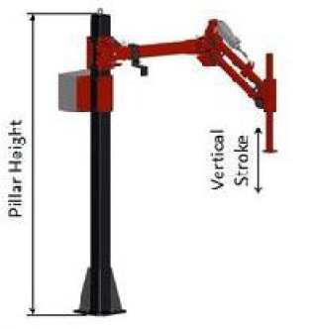
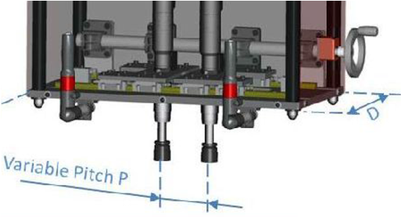
Hanging and Torque reaction arrangement for KUKEN PTS series

Slide 10
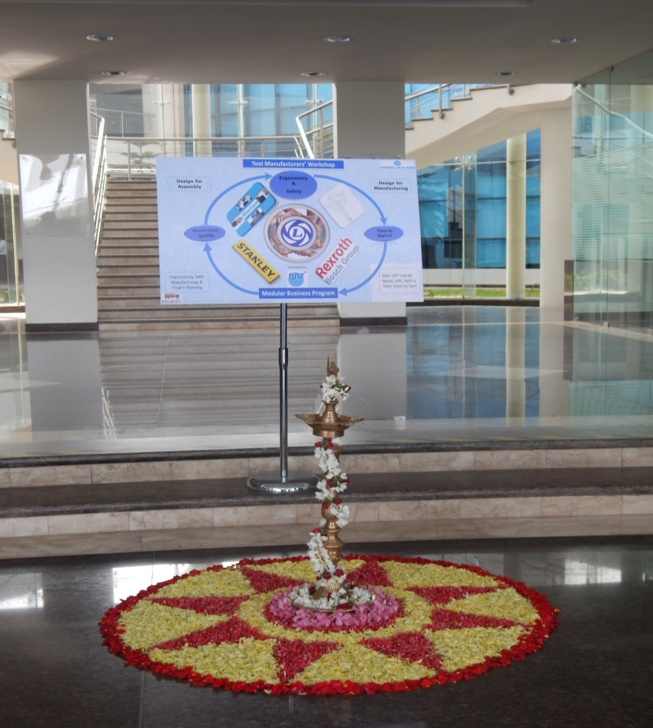
PAT A NAME TO RECOGNIZE

Slide 11





