Slide 1




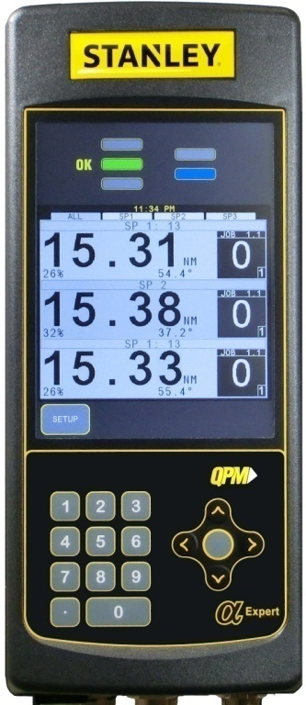

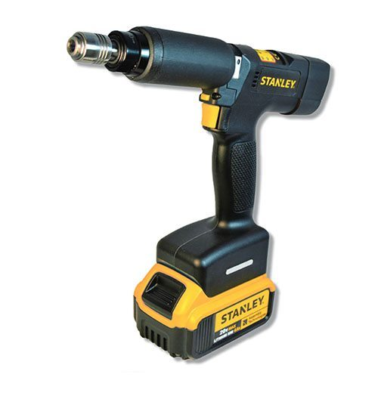
Expert
QB Alpha Expert Controller

Slide 2
























ENTERTAINMENT 4.0
Picture editing
GALARY
ACTIVATED
Movie
ACTIVATED
On line
Music
ACTIVATED
Smartphone music
ACTIVATED
ACTIVATED
YOUTUBE
USB movie
ACTIVATED
ACTIVATED
Streaming
Movie
USB music
MP3
Music
ACTIVATED
ACTIVATED
ACTIVATED
MUSIC PLAYER
Game in solo
ACTIVATED
ACTIVATED
Web browser
Downloaded game
ACTIVATED
ACTIVATED
App download
GAMING
Speaker
ACTIVATED
ACTIVATED
Download game
extension
ACTIVATED
FM RADIO
Network game
ACTIVATED
ACTIVATED
OUTLOOK
Video Camera
ACTIVATED
SOCIAL MEDIA
ACTIVATED
ACTIVATED
ACTIVATED

Slide 3






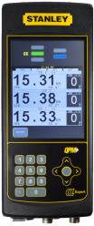


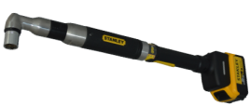

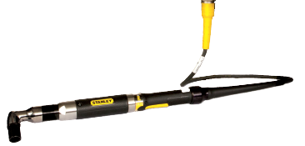



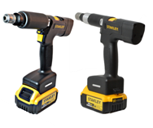
INDUSTRY 4.0
OK
Virtual Cable
VNC
Remote HMI
ACTIVATED
Tag holder
Stack light
ACTIVATED
ACTIVATED
X-Y Tracking
Control panel
CONNECT with
ACTIVATED
Fields Bus
ACTIVATED
Reporting
ACTIVATED
Protocols
ACTIVATED
Extra PSet
Extra AP
ACTIVATED
ACTIVATED
Pivot ware
ACTIVATED

Slide 4
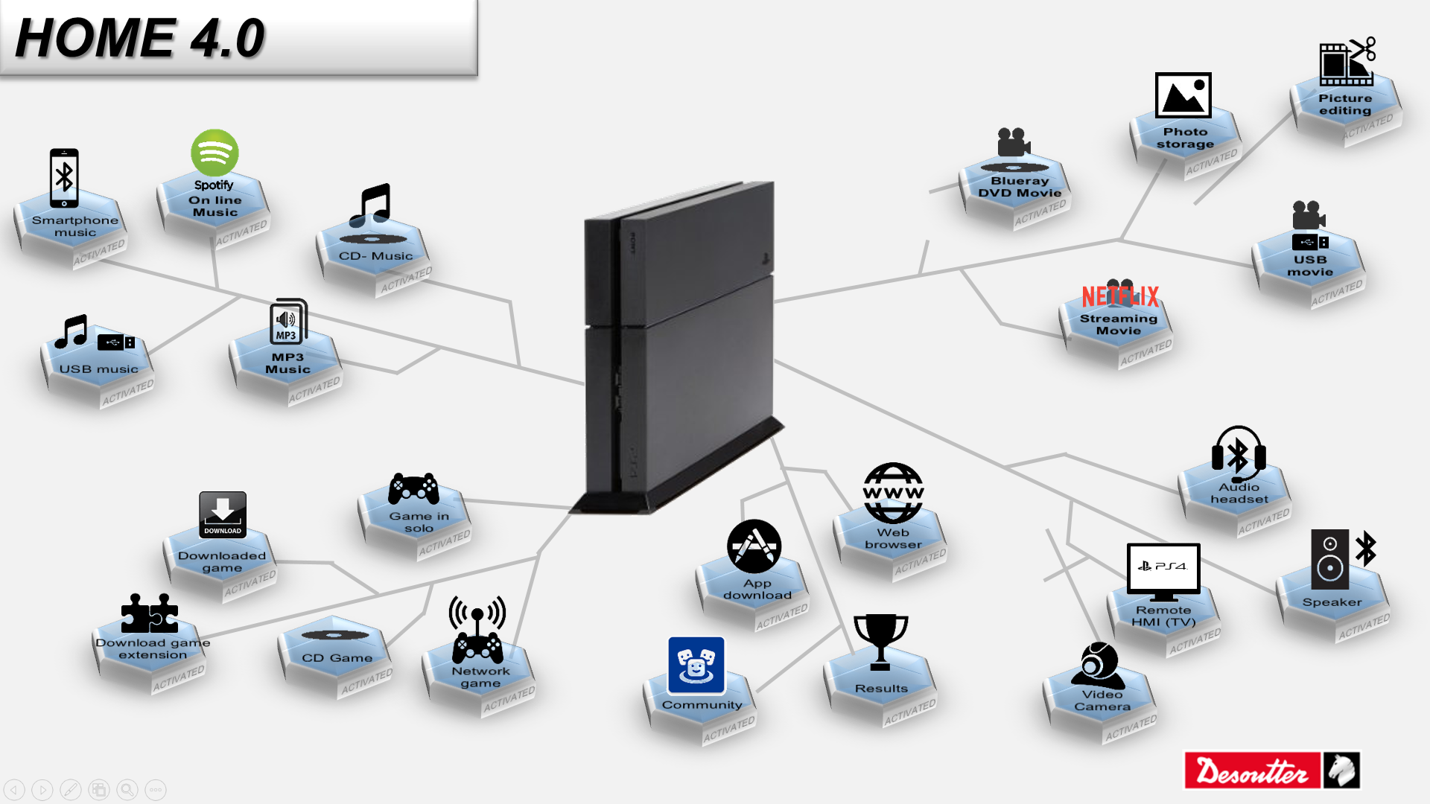
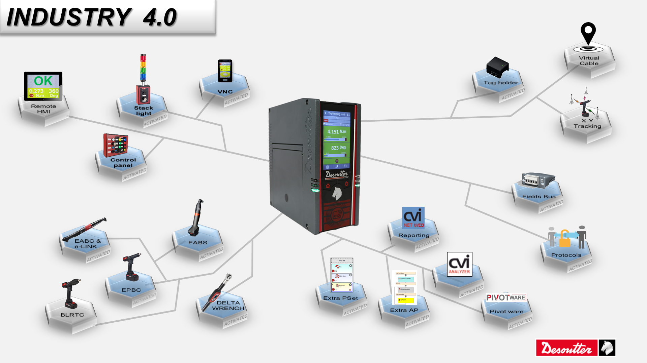


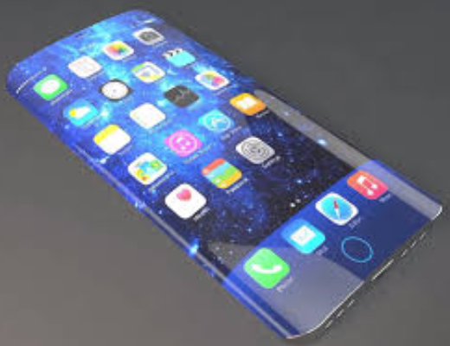



INDUSTRIAL SMART HUB
Focus on Assembly line
SMART MOBILE
Focus on Entertainment
Industry
Home
Assembly
Entertainment
Multi-features
provider
Multi-features
provider

Slide 5


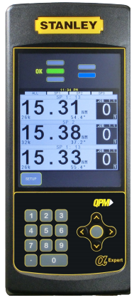
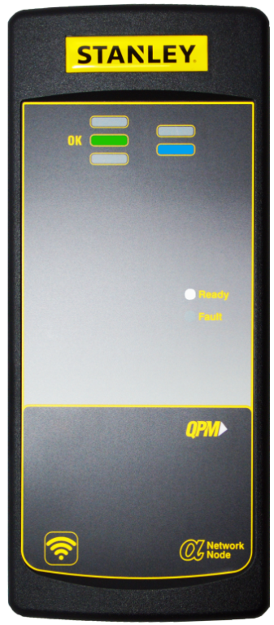
C NNECT with
Expert
Network Node
INDUSTRIAL SMART HUB

Slide 6
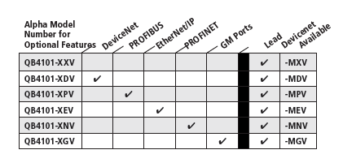

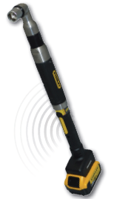


Slide 7

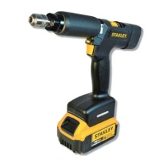

Single point
of connection

Slide 8


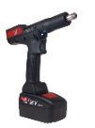
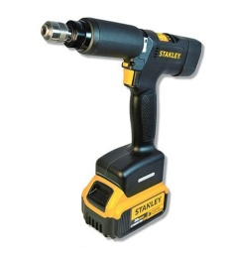







NOT
FEATURE MANAGEMENT
Expert
Advanced Strategy
Network Management
ACTIVATED
OK
ACTIVATED
Tightening Unit management
Communication
ACTIVATED
ACTIVATED
Accessories Management
Protocols
ACTIVATED
ACTIVATED
Reporting
ACTIVATED
Quality Control
ACTIVATED
Notes:
Resutilisation des UV par Tightenings Unit pur par CONNECT
Securisation
Remettre les UV dans le ewallet c’est possible ?

Slide 9
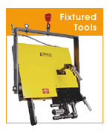
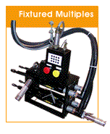


Engineered Systems
Standard and Custom Solutions
  Torque Tubes and Articulating Arms
  Bolt Holding Nutrunners
  Multiple Spindle Nutrunners
  Semi-automated Nut runner Equipment
  Conventional Material Handling

Slide 10
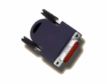
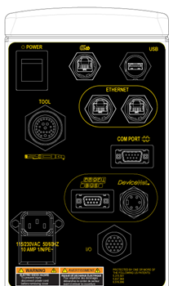
Advantages of Alpha Expert Controller
Universality of Controllers
Common Controller Platform
No need Tool Key (RBU)
Low cost of maintenance, less inventory.
Reduced cost of training.
Common power source.
Free Embedded Programming Software:
Embedded software – Alpha Toolbox.
No license for software needs to be purchased.
No extra hardware.
Web Browser and Lan Cable required.
Wi-Fi Connectivity
Easy to connect

Slide 11


Slide 12



