Slide 1


Discover the PACE

Slide 2



Discover the Freedom

Slide 3

Discover the Freedom

Slide 4


Discover the Freedom

Slide 5

Discover the Freedom

Slide 6

Discover the Freedom

Slide 7
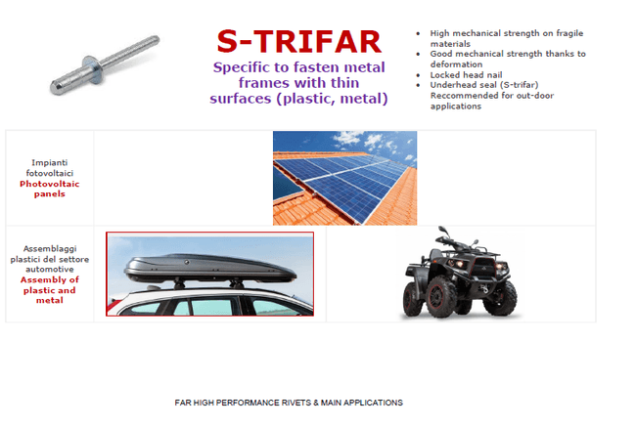

Slide 8
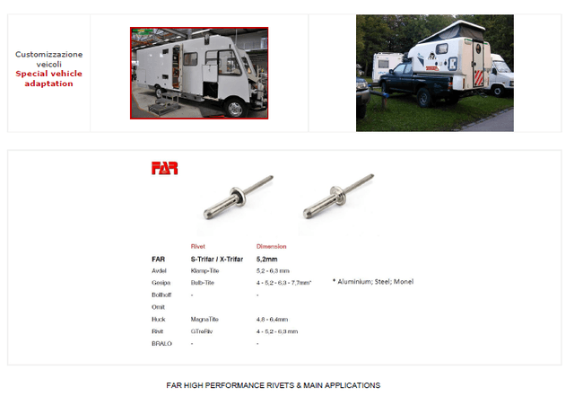

Slide 9
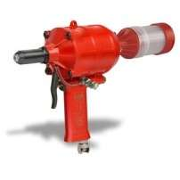
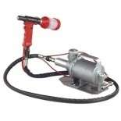
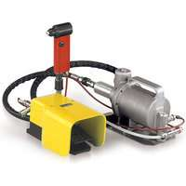
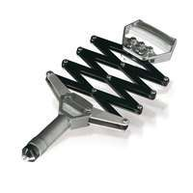
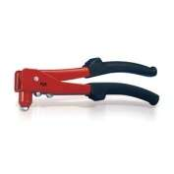
WE ARE CLOSE TO YOU , PL CALL US
Discover the Freedom

Slide 10
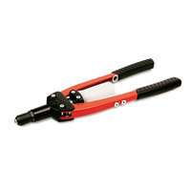
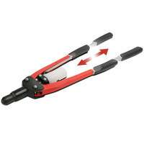


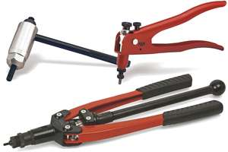

Discover the Freedom

Slide 11
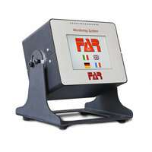
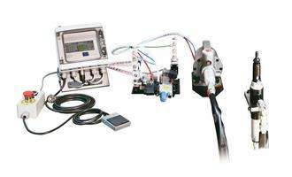
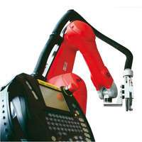
SPECIAL PURPOSE RIVETING SOLUTION
Discover the Freedom

Slide 12
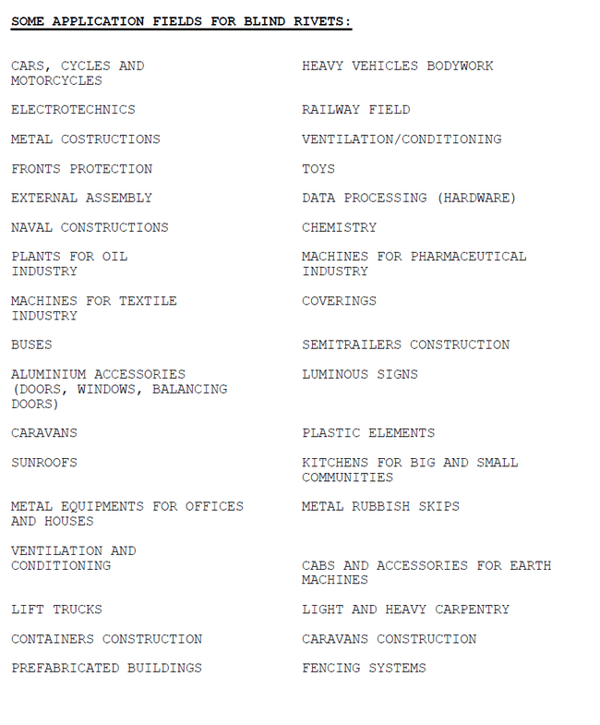
Discover the Freedom

Slide 13
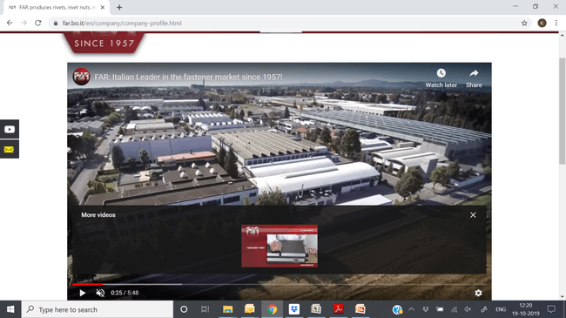
THANK YOU
Discover the Freedom

