Slide 1



PACE ASSEMBLY TOOLS
MOUNTZ PRODUCTS

Slide 2
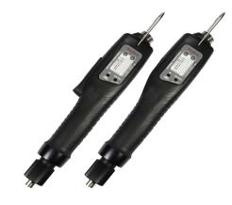
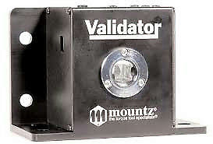
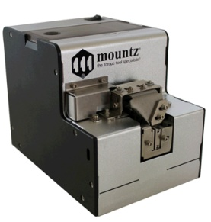
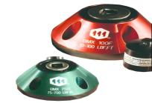
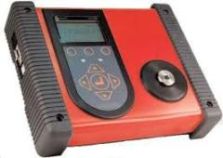
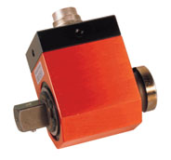
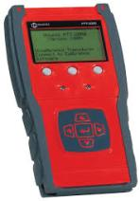
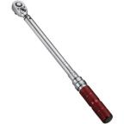
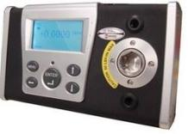
MOUNTZ Products
  High end DC Brushless Screwdrivers
  Torque Tester/Sensor/Calibrator
  Torque Wrenches
  Screw feeder and Screw presenter

Slide 3
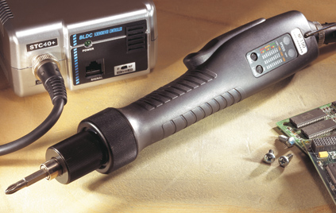
MOUNTZ - DC BRUSHLESS ESD
1)Brushless Electric Screwdriver
2)ESD Electric Screwdriver
3)Soft-Start Electric Screwdriver
4)Robotic Electric Screwdriver
5)Clean Room Electric Screwdriver
6)Vacuum Electric screwdriver
7)Cordless Electric screwdriver

Slide 4
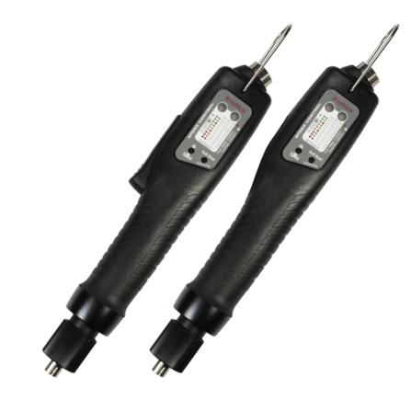
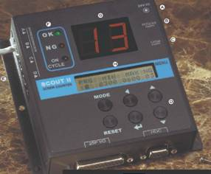
MOUNTZ -E drive DC Torque Control System
:
  DC Brushless Motors provides Durability
  Over Heat Protection(OHP) & Over Current Protection(OCP)
  External Torque adjustment scale

Slide 5
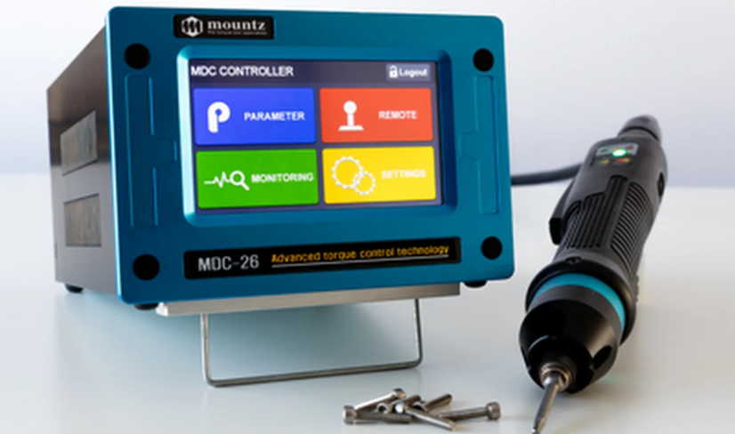
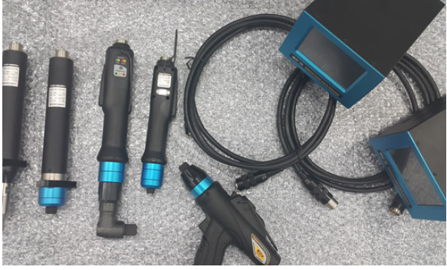
MOUNTZ – DC Electric Screwdriver system
Compliance to 4.0
Features:-
1)Increase productivity with one tool instead of 2 - 8 tools. Provides a consistent repeatable process control and eliminates potential variations.
2) Traceability and error-proofing. Real time monitoring. Swiss DC servo motor provides precise, accurate and repeatable torque control.
3) Digital I/O signals for communication with external devices such as PLC.
4) Up to 15 process sequences with 10 program steps
5) Collect and save all fastening data on SD memory card.
6) Fastening torque data analysis (Standard Deviation, Mean, Average, CP, CPK ) with TPM (Torque Process Monitoring) Touch Screen accessory option.`

Slide 6
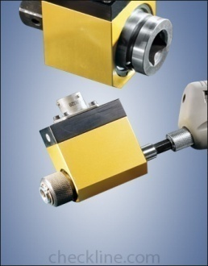
MOUNTZ-Torque Testers/Sensors
EZ-TorQ Series ( Upto 17 Nm)
LTT series(Upto 339 Nm)
BMX Sensor(Upto 27116Nm)
Low Torque Ranges(Electric Screwdriver)
Medium Torque ranges(Oil Pulse Tools)
High Torque Ranges(Direct drive and DC NR)
STATIC
DYNAMIC/ROTARY

Slide 7
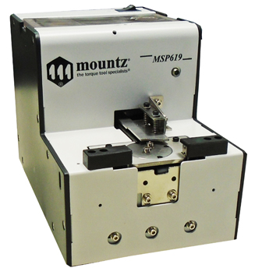
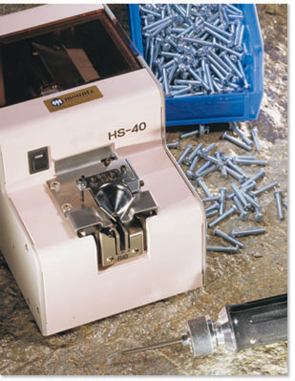
MOUNTZ-Screw feeder/ Screw presenter
To know more about above products please click below
https://youtu.be/5Z6YEcj79uU

Slide 8
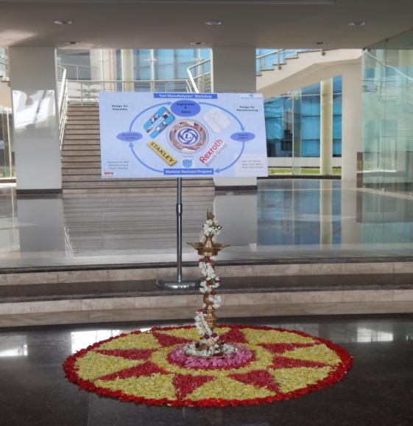
PAT A NAME TO RECOGNIZE

Slide 9



