Slide 1
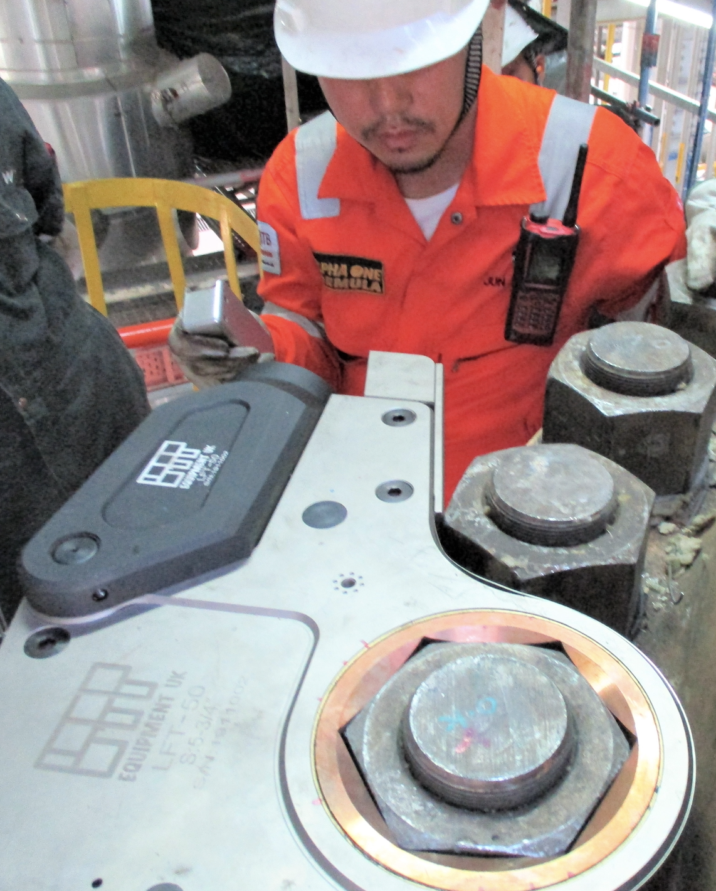


Bringing the Best Solutions
and a Unique Proven Ethos to India
Flange working equipment supplier and global bolting training specialists LAPP Equipment UK Ltd, have teamed up with Indian tooling specialists Pace Assembly Tools, to further strengthen their global presence.
LAPP Equipment UK Ltd have been supplying their UK and US made flange working globally for quite some time however, this development illustrates their commitment to accelerating their continued growth. Built upon their “Three T” principles of joint integrity assurance, “Training, Traceability & Tooling”, LAPP Equipment UK Ltd are already a leading player in the industrial bolting and flange working sector across much of the world.
As their name suggests, Pace Assembly Tools specialise in supplying industrial tooling in India to a broad range of sectors including, Oil & Gas, Power Generation, Heavy Engineering and many more.
Chris Stimpson, Global Sales Director for LAPP Equipment UK Ltd commented “We are delighted to be working with Pace Assembly Tools. Working with them will give us the edge required to make further strategic gains in a country with great potential for our products and services. We are all very excited about what the future will bring.”
This is yet another great example of the commitment within LAPP Equipment UK Ltd to promote continued growth as a truly global organisation, bringing the very best solutions to their clients and providing a level of customer service second to none.
For more information on both organisations visit www.lappuk.co.uk and www.pacetools.in

