Slide 1



PACE ASSEMBLY TOOLS

Slide 2

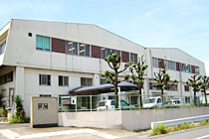
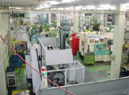

Company Introduction
Company name: KUKEN Co. Ltd.
Established : March 1968
Head Office :Habikino-Shi,Osaka
Acquired Std:ISO 9001:2008, JIS Q 9001:2008

Slide 3

KUKEN Products
Fastening Tools
Speciality Tools
Sanding Tools/Polishing Tools
Drilling Tools/Grinding Tools
Cutting Tools

Slide 4


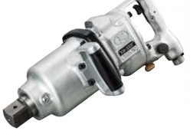
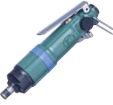


Fastening Tools
Impact Wrenches/Drivers
Oil Pulse Wrench

Slide 5
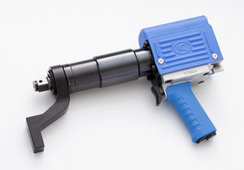

Advanced Torque Control Tool
PTS (Power Torque Setter)
Extremely accurate(5%)
Reaction is absorbed through reaction arm
3 different torques can be set .
Data saving system
Extremely Low Vibration & Noise
High Torque range:5000Nm

Slide 6

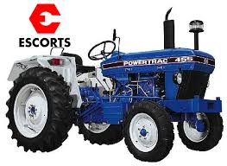
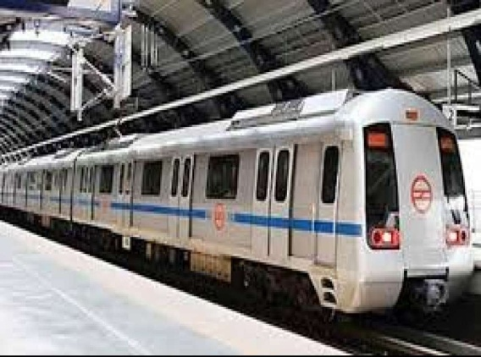

Application of PTS Series Tools
Wheel Tightening for Bus & Trucks
Public Transport Maintenance
Power Plant Maintenance

Slide 7

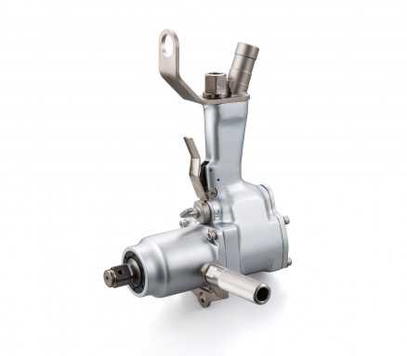

Speciality Tools
N Type Clutch Tools
High power :650Nm
For Crank pulley bolts, timing belt & narrow places
Low cost :Maintenance cost is very low
Long exhaust hose to avoid ocean contamination
Original N type Clutch
Suitable for off shore operations, port constructions, ship maintenances, etc.

Slide 8
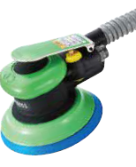
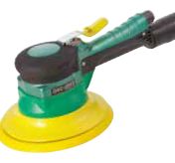

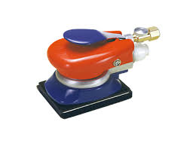
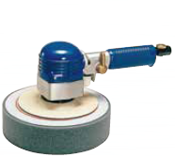
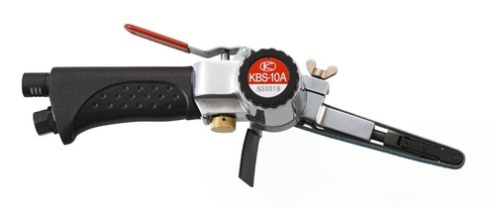
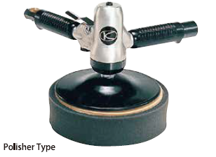

Sanding/Polishing Tools

Slide 9
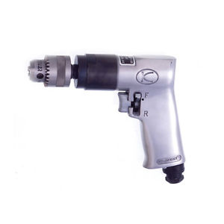
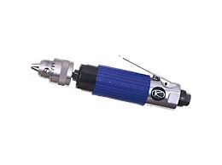
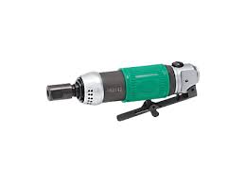
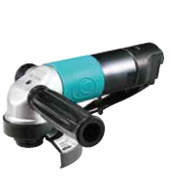
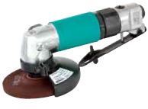
Drilling & Grinding Tools

Slide 10
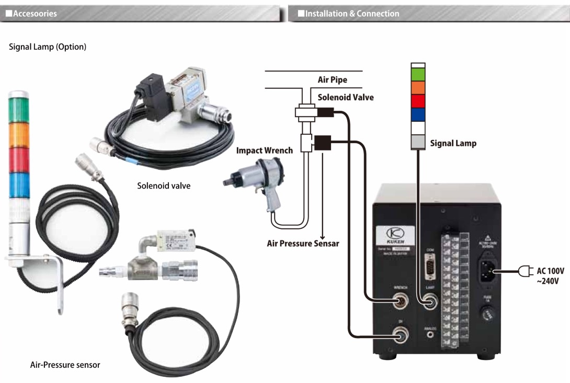
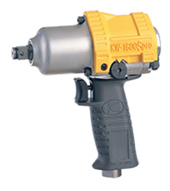
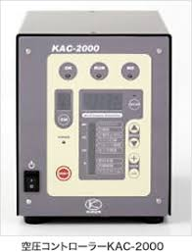
POKA YOKE System from KUKEN

Slide 11

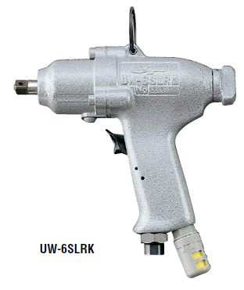
Key features of KUKEN Tools
(EYE OPENER)
KUKEN URYU
KW-7P UW-6SLRK
Noise Level~77.5dBA Noise Level~93dBA

Slide 12



