Slide 1
PACE ASSEMBLY TOOLS
TORERO Products
A NAME IN THE FIELD OF PULSE TOOLS

Slide 2
TORERO Products
Pneumatic Tools
Cordless Tools
Special Application Tools
Pulse tools.
LOW AIR PRESSURE PULSE TOOLS

Slide 3
TORERO - Oil Pulse Tools
4 to 5 bar
Save Air
Tool Orientation:
Pistol
Screwdriver
Shut-off (4-35Nm)
Non Shut-off (6-40Nm)
Pulse Wrench
Shut-off (5-250Nm)
Non Shut-off (3-130Nm)
Pistol
LOW AIR PRESSURE PULSE TOOLS

Slide 4
TORERO - Oil Pulse Tools
Straight type:
Screwdriver
Shut-off (4-35Nm)
Wrench
Shut-off (4.5-63Nm)
In line
Geared type (Non Shut-off) :
Wrench Straight(28-34Nm
Wrench 26° (28-34Nm)
Geared Wrench

Slide 5
TORERO - Oil Pulse Tools
Angle type:
Shut-off (7-50Nm)
Non Shut-off (15-85Nm)
Angle
Open Crowfoot

Slide 6
TORERO–Cordless Clutch Tools
Pistol (Torque 12 Nm)
Angle (Torque 35Nm)
Closed End(Torque 30Nm)
Open End(Torque 30Nm)

Slide 7
TORERO– Cordless Clutch Tools

Slide 8
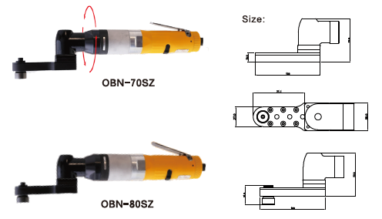
TORERO–-Special Application Tool

Slide 9
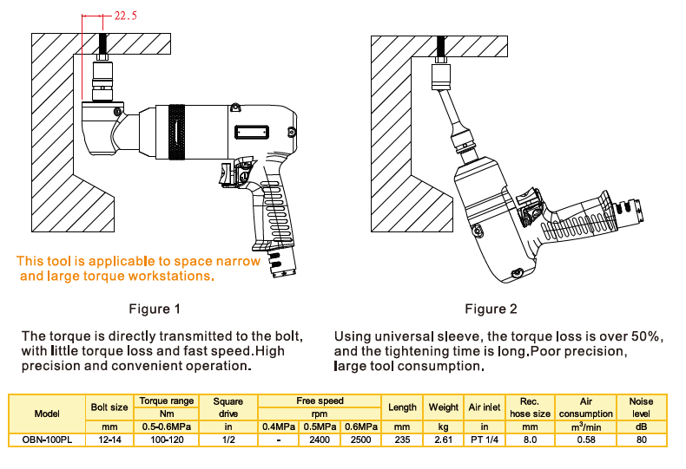
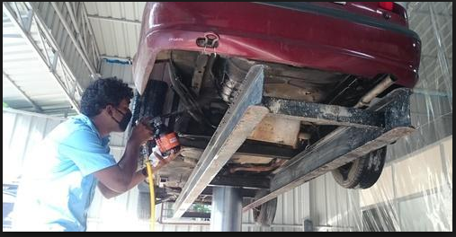
TORERO–-Special Application Tools
Application

Slide 10
Our Branches & Contact details
Rudrapur Mr.Navneet Kr 9219691708 pantnagar@pacetools.in
Bangalore Mr.Goutham 8754601641 bengaluru@pacetools.in
Faridabad Ms. Maithily Singh 7290092247 maithily@pacetools.in
For escalations: Mr. K.K.Maitra-Business Head Cell: 9810618168 kk.maitra@pacetools.in
HEAD OFFICE :1A/27,NIT Faridabad-121001(HARYANA)
Email:satyendra@pacetools.in,9810170873 (Managing Director)
HELPDESK:helpdesk@pacetools.in, 9990860873
Tel:0129-4080699,7290092247

Slide 11
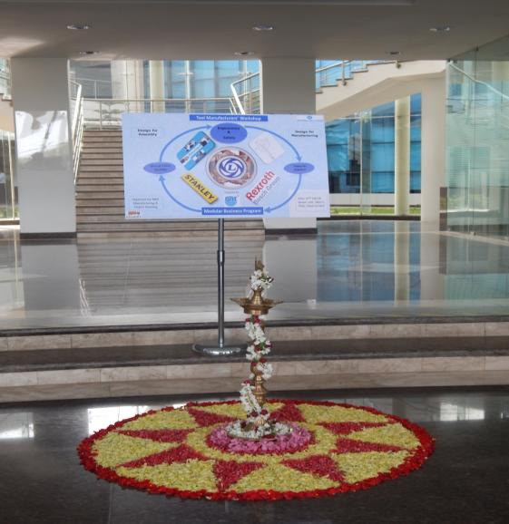
PAT A NAME TO RECOGNIZE

